Slide 1

Crowdsourcing Metadata – Challenges and Outlook
Montreal, 29 April 2016
Lars Vilhuber (Cornell University)
Notes:
Abstract:
Recent years have shown the power of user-sourced information evidenced by the success of Wikipedia and its many emulators. Agencies on the other hand publish metadata on their data products, but have little opportunity to get structured feedback on that metadata (codebooks) from their users. Creating and augmenting metadata is a labor-intensive endeavor. Harnessing collective knowledge from actual data users can supplement officially generated metadata. As part of our Comprehensive Extensible Data Documentation and Access Repository (CED²AR) infrastructure, we demonstrate a prototype of crowdsourced metadata (codebooks), using DDI-C and supplemental XML. The system allows for any number of network connected instances (web or desktop deployments) of the CED²AR DDI editor to concurrently create and modify metadata. The backend transparently handles changes, and frontend has the ability to separate official edits (by designated curators of the data and the metadata) from crowd-sourced content. Features of the software allow official curators to merge in select enhancements into revisions of official documentation. CED²AR ingests and publishes widely-used DDI metadata standards, and can thus easily augment existing metadata publishing systems. Using standards-compliant ingest and publication methods, our proposed crowd-sourced metadata system can greatly enhance user acceptance of documentation, user-engagement in the documentation process, and reduce agency costs while improving the quality of data documentation. This development is part of the NSF-Census Research Network node at Cornell University.

Slide 2

Crowdsourcing Metadata – Challenges and Outlook
Montreal, 29 April 2016
Lars Vilhuber (Cornell University)
Notes:
Abstract:
Recent years have shown the power of user-sourced information evidenced by the success of Wikipedia and its many emulators. Agencies on the other hand publish metadata on their data products, but have little opportunity to get structured feedback on that metadata (codebooks) from their users. Creating and augmenting metadata is a labor-intensive endeavor. Harnessing collective knowledge from actual data users can supplement officially generated metadata. As part of our Comprehensive Extensible Data Documentation and Access Repository (CED²AR) infrastructure, we demonstrate a prototype of crowdsourced metadata (codebooks), using DDI-C and supplemental XML. The system allows for any number of network connected instances (web or desktop deployments) of the CED²AR DDI editor to concurrently create and modify metadata. The backend transparently handles changes, and frontend has the ability to separate official edits (by designated curators of the data and the metadata) from crowd-sourced content. Features of the software allow official curators to merge in select enhancements into revisions of official documentation. CED²AR ingests and publishes widely-used DDI metadata standards, and can thus easily augment existing metadata publishing systems. Using standards-compliant ingest and publication methods, our proposed crowd-sourced metadata system can greatly enhance user acceptance of documentation, user-engagement in the documentation process, and reduce agency costs while improving the quality of data documentation. This development is part of the NSF-Census Research Network node at Cornell University.

Slide 3
Acknowledgements
Based on work with
Benjamin Perry (formerly Cornell University)
Venkata Kambhampaty (formerly Cornell University)
Kyle Brumsted (McGill University)
William Block (Cornell University)
Jeremy Williams (Cornell University)
Carl Lagoze (University of Michigan)
John Abowd (Cornell University)
and materials presented in INFO 7470, all of that with funding by NSF Grant #1131848

Slide 4
What’s the problem?

Slide 5
I’m going to argue that…
Replicability is a problem…
and (A) easier deposit methods could alleviate it
but progress is slow

Slide 6
I’m going to argue that…
Having replicable archives shifts the problem…
in time: (B) older articles cannot be linked to data
in scope: (C) curators need expert help in documenting the data

Slide 7
Replicability is a mess…

Slide 8
Verification Is Important
Falsifying data
Andrew Wakefield (autism and vaccines)
Yoshitaka Fujii (fabricated data in 172 out of 249 papers)
“Believe it or not: how much can we rely on published data on potential drug targets?” doi:10.1038/nrd3439-c1 – Drug maker cannot replicate more than 20-25% of findings
“Why Most Published Research Findings Are False” Ioannidis JPA (2005) doi:10.1371/journal.pmed.0020124

Slide 9
Recent Replication Exercises
Psychology:
Open Science Collaboration (2015) “Estimating the reproducibility of psychological science,” Science 28 Aug 2015: Vol. 349, Issue 6251, DOI: 10.1126/science.aac4716:

Slide 10
OSC (2015) Replication Exercises
(100 studies)
“one-third to one-half of the original findings were also observed in the replication study”

Slide 11
Recent Replication Exercises
Behavioral economics:
Camerer et al. (2016), “Evaluating replicability of laboratory experiments in economics,” Science 03 Mar 2016, DOI: 10.1126/science.aaf0918:

Slide 12
Camerer et al. (2016) Replication Exercises
(18 studies)
“significant effect in the same direction as the original study for 11 replications (61%)”

Slide 13
We took a different approach
LDI “reproducibility” project:
Kingi, Stanchi, Vilhuber (2016, unpublished) “The Reproducibility of Economics Research”

Slide 14
Kingi, Stanchi, Vilhuber (2016)
109 articles in American Economic Journal: Applied Economics
Simpler test:
Do the provided data and programs yield the published results?

Slide 15
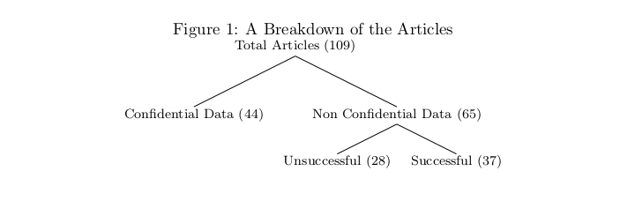
Kingi, Stanchi, Vilhuber (2016)

Slide 16
Kingi, Stanchi, Vilhuber (2016)
New question:
Are the provided data and programs accessible?

Slide 17
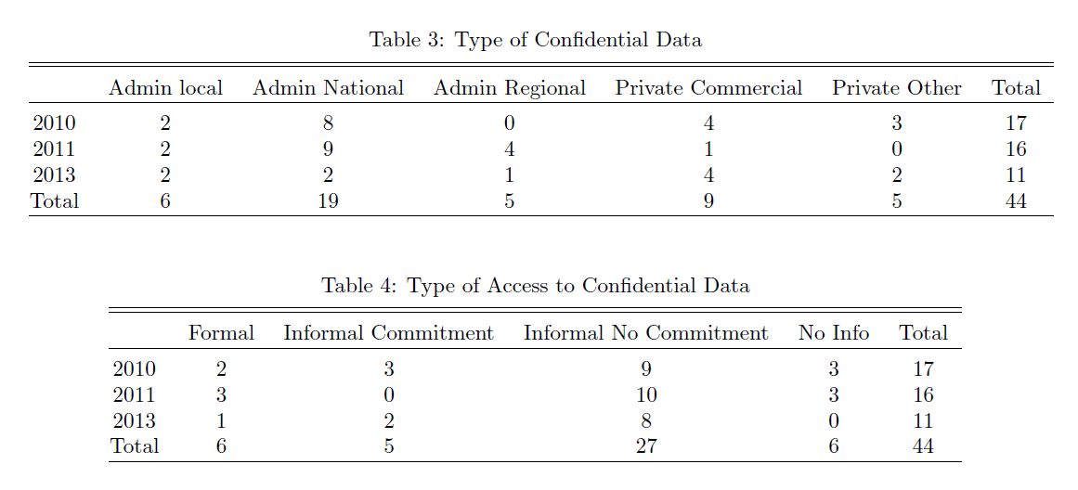

Slide 18
What’s part of the problem?

Slide 19
A: Lack of proper deposit

Slide 20
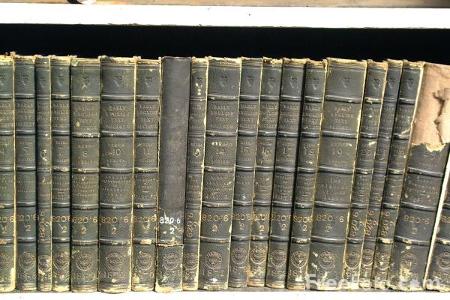
The old source of knowledge – and data!
Source: http://www.thecontrarianmedia.com/2011/08/dispatches-from-the-stacks-15/
License unknown

Slide 21

https://www.flickr.com/photos/15472273@N07/6931305440/in/photolist-byuKCd-oh6Bxu-bMpoYn-aUxMUX-aUxPKF-aUxNwv-aUxNiH-aUxN2V-aUxNb6-aUxNqe-aUxP4F-aUxNLB-biAicF-biA9ar-aUxMte-biAftF-aUxLXr-aUxLKT-aUxMBc-fUMhDZ-pQm1F1-oaGC6t-6Juv4g-6JuiTM-oh78Mr-oyA1Gk-qssnzU-bMpunF-byuB5L-bMpf3n-qKP4GF-qKDrYF-dBNTRV-hEQRCt-Eag36-6Juv46-6Juv3R-6JxXpw-6Ju7Rt-6JxXpN-eJGN8U-6JuiTB-6JuiTx-6JuiU4-6JsUMD-6JsUMZ-6JuiTg-6Ju7R6-6Ju7RH-6JxXpo (Stadtbibliothek Stuttgart am Mailänder Platz) CC 2.0
Notes:
Even if this may be the future

Slide 22

The City – by Lori Nix
https://louisvillephotobiennial.files.wordpress.com/2015/05/library.jpg
License unknown

Slide 23
It’s mental…

Slide 24

Where do your university’s Ph.D. theses go?

Slide 25
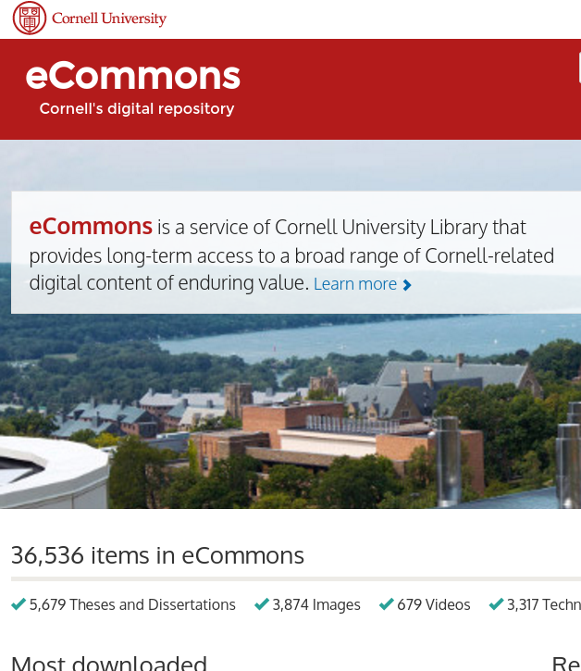
Or more likely

Slide 26
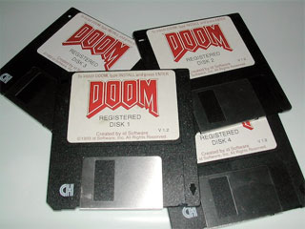
Where do your researchers’ data go?
Their computer?
Dropbox?

Slide 27
Where can researchers go?

Slide 28
Options are available

Slide 29
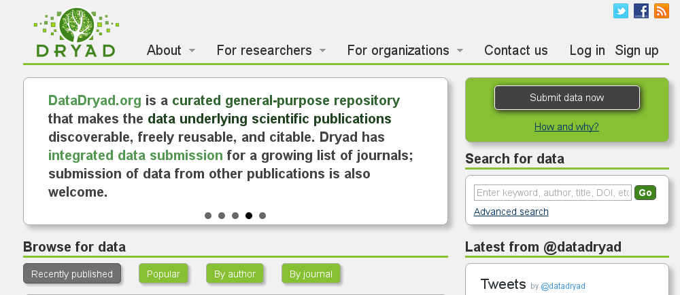
Options are available
Earth and natural sciences

Slide 30

Options are available
Social and behavioral sciences

Slide 31
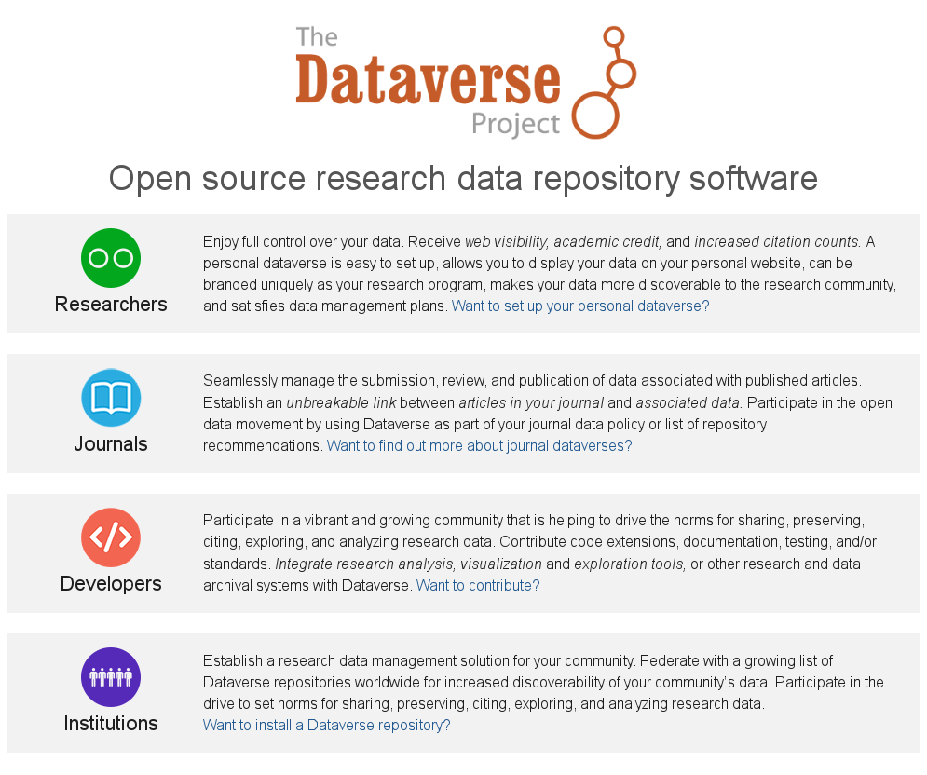
Options are available
“Research data”

Slide 32
Three main problems

Slide 33
Three main problems
Researchers don’t use them
When researchers use them, usage is suboptimal (but better than nothing!)
Journals don’t point to them
Don’t work for many researchers at all

Slide 34
Researchers don’t use them
Training? Incentives? Ease of use?

Slide 35
Some Case Studies

Slide 36
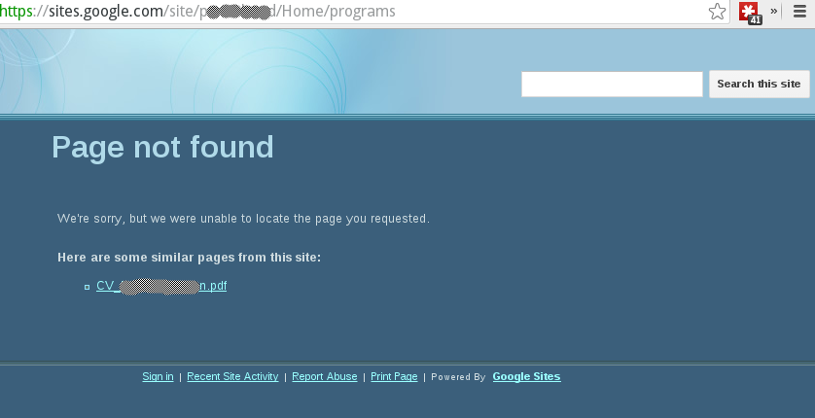
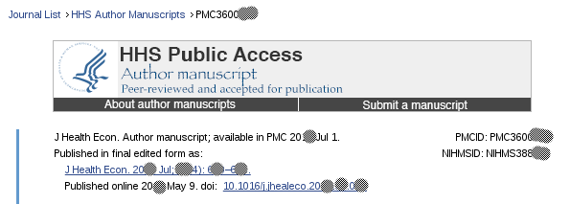
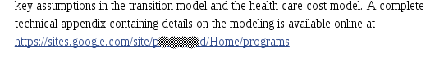
Self-archiving

Slide 37
Or…
“… to respond to the request, I had to turn on the old computer, quickly find the files on the HD, before it overheated and shut down.”

Slide 38
Problems When There Is a Will
Storage on Google, Dropbox, etc. relies on personal payment of recurring cost by researcher
Inadvertent reorganization leads to retrieval failure

Slide 39
Problem when relying on cooperation
“we couldn't replicate the results in Allegretto, Dube, Reich, and Zipperer's (ADRZ) 2013 working paper -- and they wouldn't share their data and code with us”
Source:
Ian Salas’ data archive at https://sites.google.com/site/jmisalas/data-and-code ,
which contains a ZIP file at https://drive.google.com/file/d/0B-UoTwKoXafUMlQxajdlRUZ2Vzg/edit,
which contains README.txt

Slide 40
A Good Example

Slide 41
Gentzkow, Shapiro, Sinkinson (2014)
Gentzkow, Matthew, Jesse M. Shapiro, and Michael Sinkinson. 2014. "Competition and Ideological Diversity: Historical Evidence from US Newspapers." American Economic Review, 104(10): 3073-3114. DOI: 10.1257/aer.104.10.3073
Data at http://doi.org/10.3886/E1361V3

Slide 42
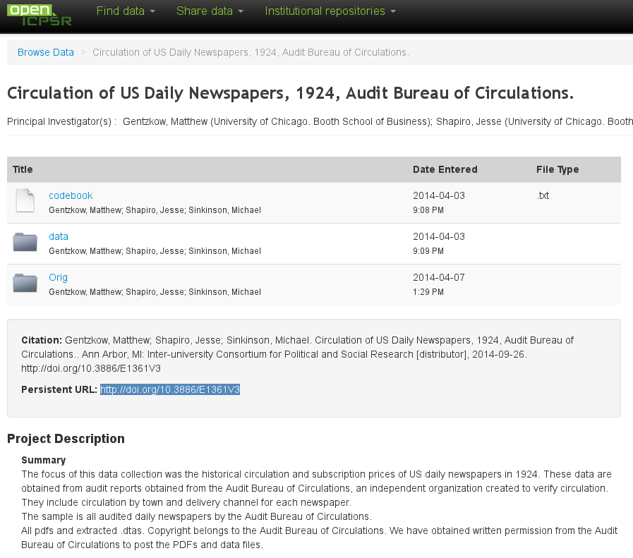

Slide 43
What’s good about this?
Permanent URL
Availability of
Original data
Transformed data
Open availability
Easy online inspection

Slide 44
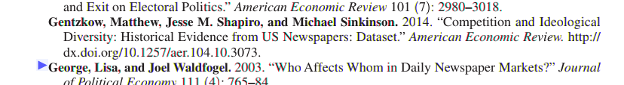
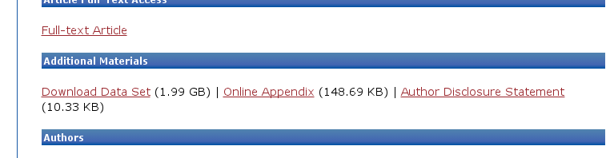
Not Perfect
Archive at openICPSR not actually tied to article and vice-versa
Conversely, “online appendix” just a “blob”

Slide 45
A Self-serving Example

Slide 46
Abowd and Vilhuber (2012)
Article: http://www.aeaweb.org/articles.php?doi=10.1257/aer.102.3.589
Appendix
Description at http://www.aeaweb.org/aer/data/may2012/2012_2790_app.pdf (note: no DOI!)
Tried to be careful about referencing data, but no DOIs available on any of the data
Even our own data (National QWI, 38MB compressed)
Only generic programs
Final dataset was too large – not accepted.

Slide 47
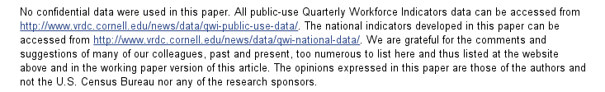
Abowd and Vilhuber (2012)

Slide 48
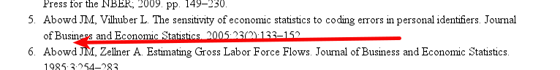
Abowd and Vilhuber (2012)
No citation of own data

Slide 49
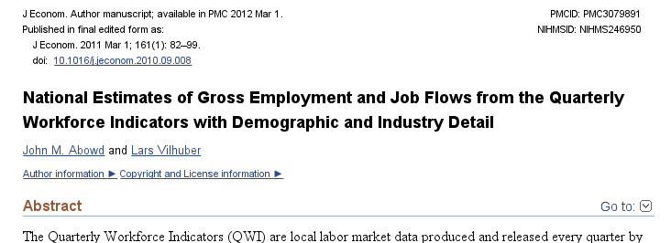
Abowd and Vilhuber (2011)

Slide 50
Abowd and Vilhuber (2011)
Later went back and added a proper replication archive
Done after the fact
No way to link article to data archive

Slide 51
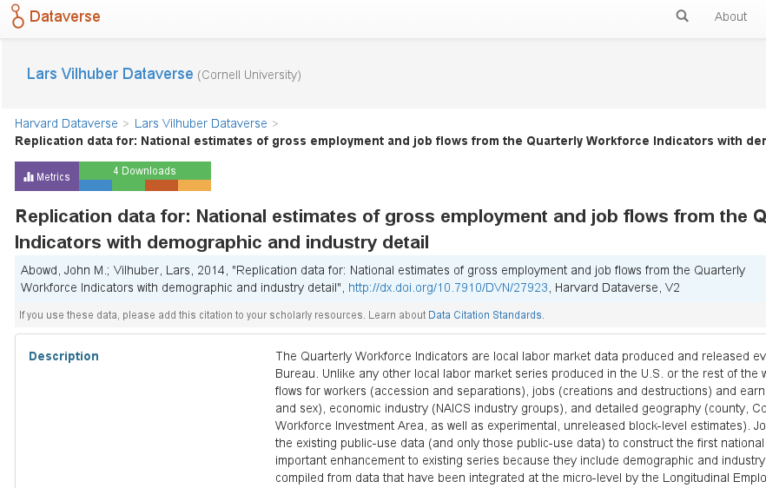
Abowd and Vilhuber (2011)

Slide 52
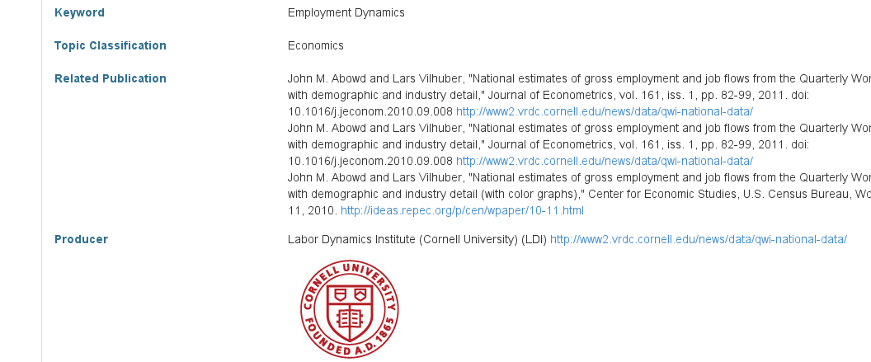
Abowd and Vilhuber (2011)
Replication archive is linked to the article

Slide 53
Abowd and Vilhuber (2011)
But no way to link the article back to the data (post-publication)

Slide 54
Journals don’t use them
… but that might be changing

Slide 55
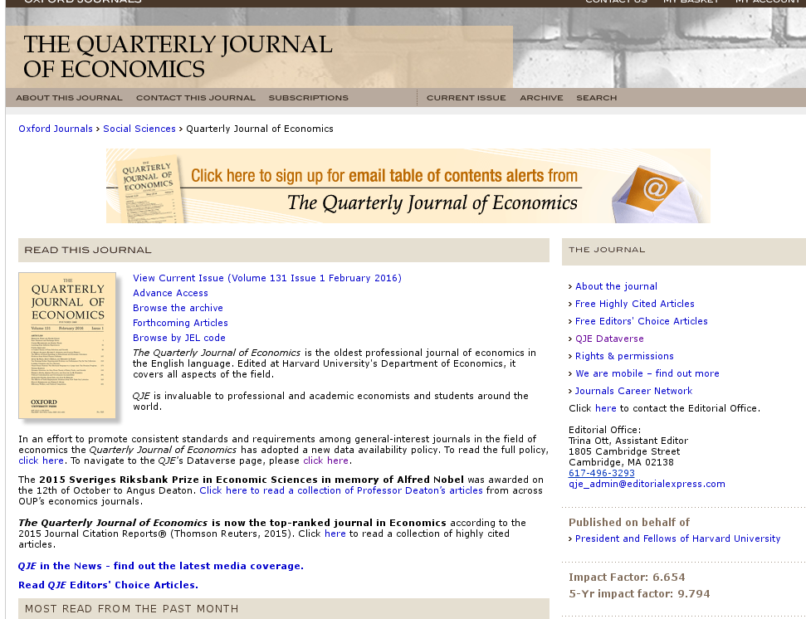
Journals are starting to use them

Slide 56
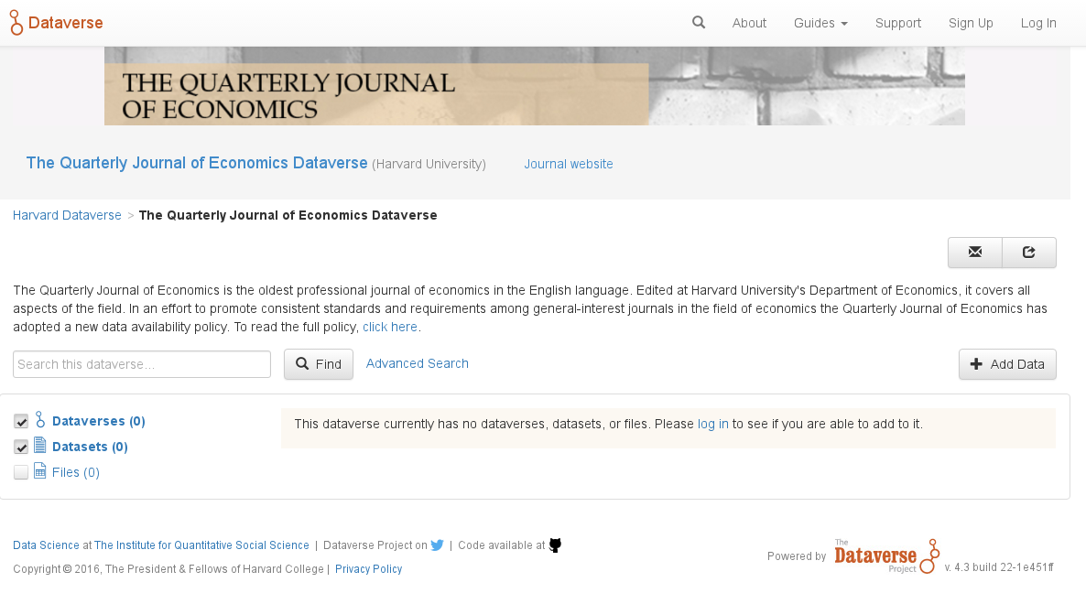
Journals are starting to use them

Slide 57
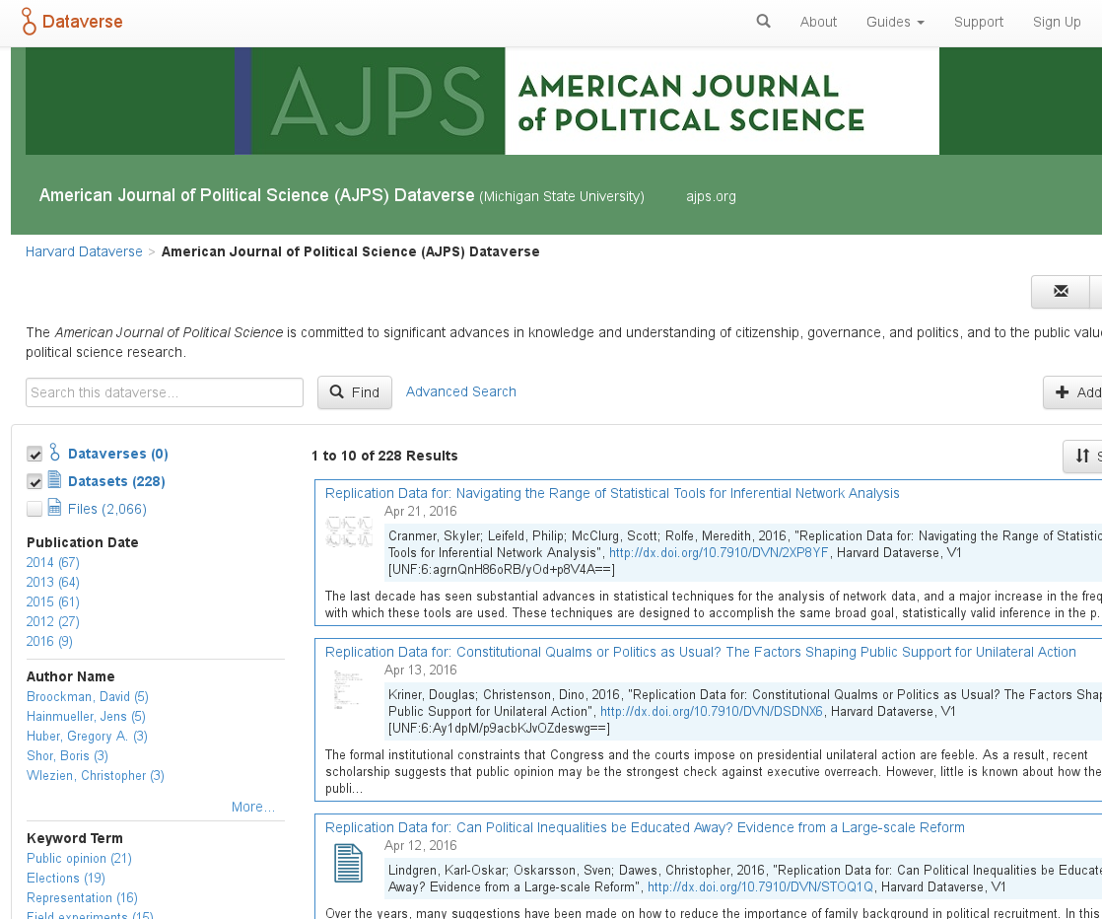
Journals are starting to use them

Slide 58
But the biggest problem…

Slide 59
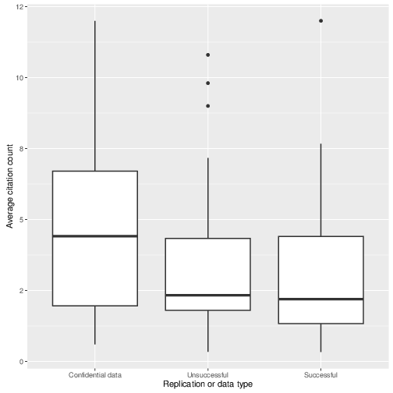
Back to confidential data
Articles using confidential data are (weakly) more cited than others

Slide 60
But: for confidential data…
Data is not available
Metadata is not available
Programs? So-so…

Slide 61

Should We Just Trust These Guys?

Slide 62
The problem cannot be solved by researchers
The data owners must be part of the solution
Statistical agencies
Government department and ministries
Private companies
Must be able to designate a trusted data custodian

Slide 63
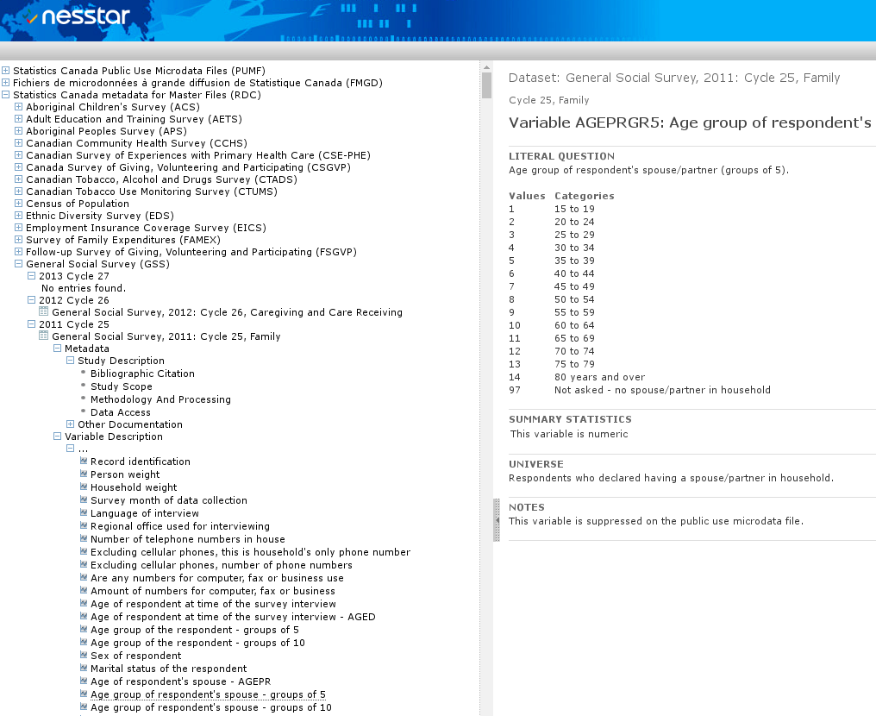
Some are quite commendable

Slide 64
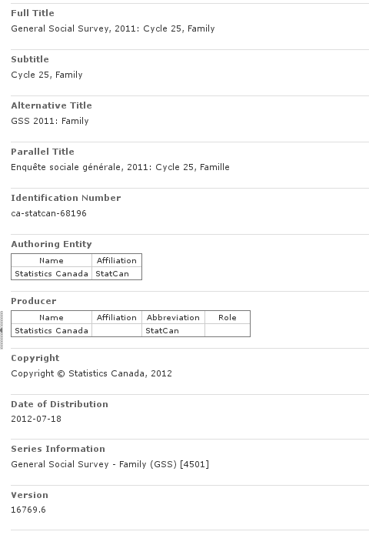
Even detailed information

Slide 65
How many users actually use that?

Slide 66
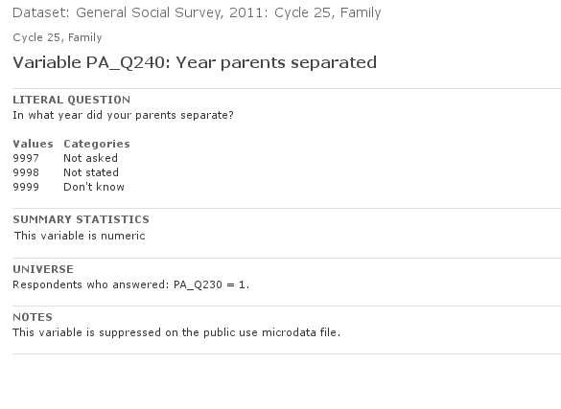
Data documentation is dry
How reliable is that question?

Slide 67
Let me take stock

Slide 68
Problems
Users don’t curate data
When they do, it’s not very good or reliable
Data providers don’t always curate data
Or don’t expose their metadata
Or don’t have metadata
Once out there, it’s as if it were on paper – immutable, and cannot be improved
Links between articles and data
Improvements to documentation of data

Slide 69
What can data librarians do?

Slide 70
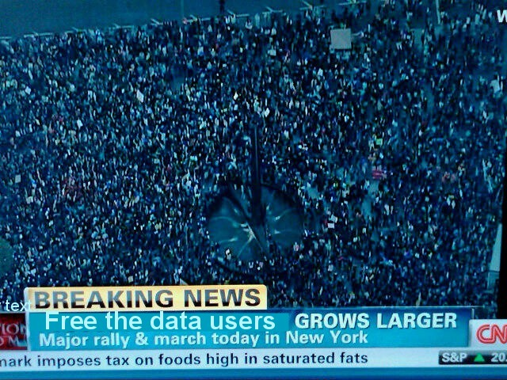
Don’t (just) liberate the data!
Liberate the data users!

Slide 71
Issues
Data curators (Agencies) lack a mechanism to obtain structured feedback for their metadata
Metadata standards for the social science community are difficult to navigate, even with complex tools
Metadata curation is a labor intensive process

Slide 72
Provide tools for users to link data to articles

Slide 73
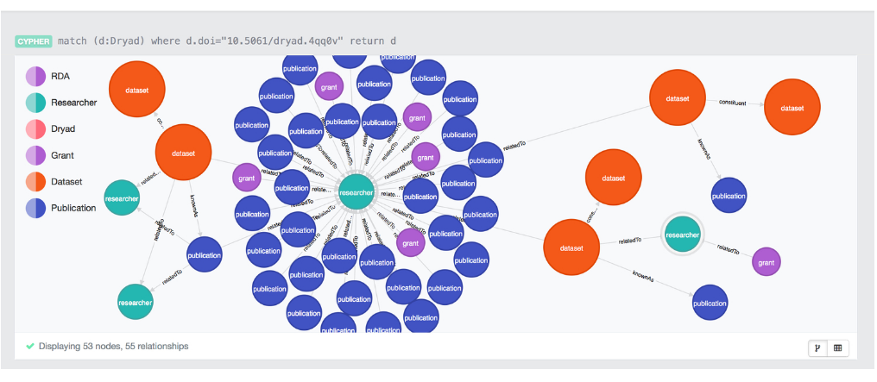
RD Switchboard is under development

Slide 74
But relies on existing metadata

Slide 75
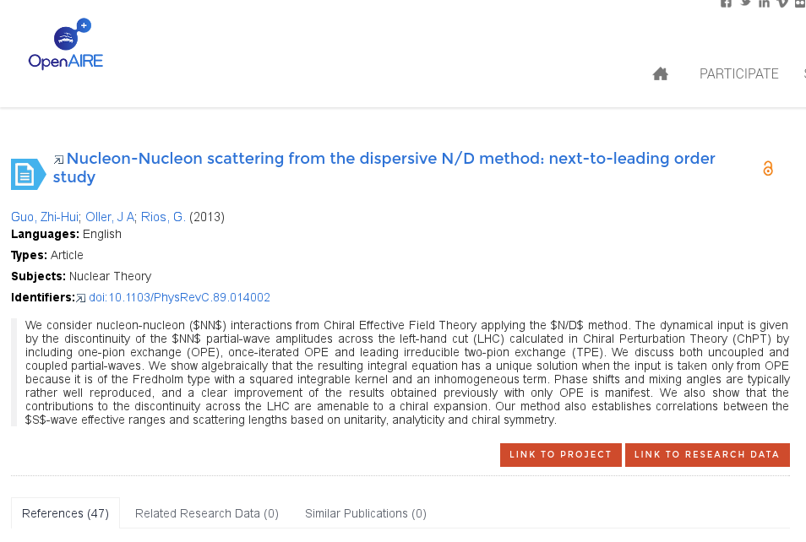
OpenAIRE attempts to do so
… allowing users to establish the link

Slide 76
Our contribution
Leverage researcher knowledge

Slide 77
Our Approach
Rely on open standards, namely the Data Documentation Initiative (DDI) schema
Provide easy-to-use tools and interfaces to structured metadata
Build infrastructure that enables data curators to leverage community-driven input to official documentation

Slide 78



How?
CED²AR
The Comprehensive Extensible Data Documentation and Access Repository
Notes:
Pronounced /ˈsidər/, like a cedar tree

Slide 79
What is CED²AR?
Metadata curation software
Designed for documenting existing datasets
Funded by NSF grant #1131848
Online at www2.ncrn.cornell.edu/ced2ar-web

Slide 80
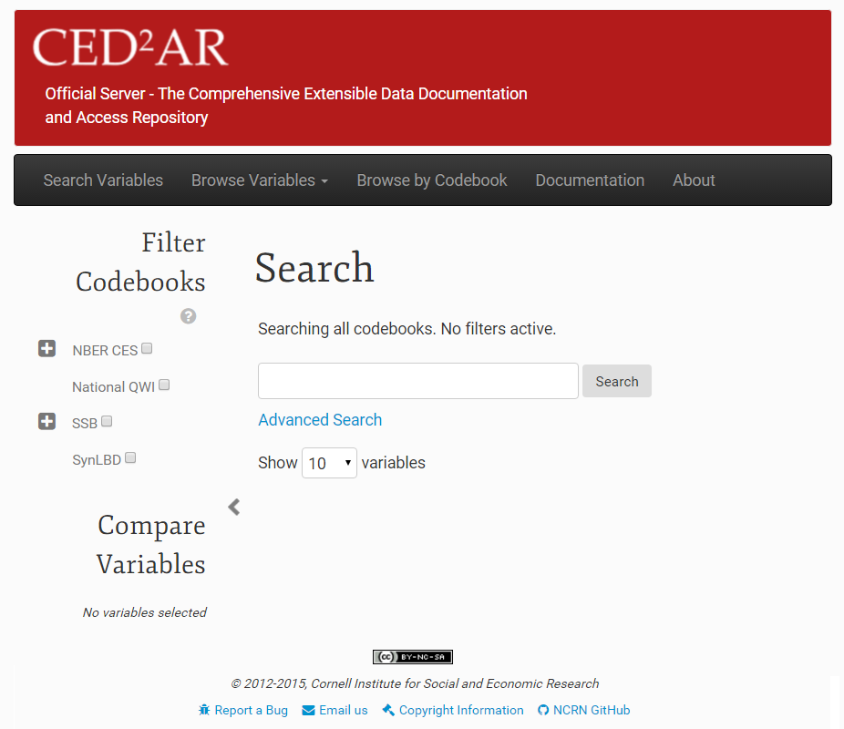
What is CED²AR?
Notes:
Web based, open source, and free for non-commercial use

Slide 81
Basic Information Flow
Staging Area
Public Facing
Official
Metadata
Datasets
Internal
Metadata
User switches
Crowdsourced
Metadata
81
Notes:
Instances of CED²AR are networked together in a distributed system – no centralized repository Three key instances exist for the curation process
An internal server to stage metadata
An official server to publish metadata
A crowdedsourced, or community server open to modifications
Metadata moves between all three instances

Slide 82
Basic Information Flow
Staging Area
Public Facing
Official
Metadata
Datasets
Internal
Metadata
User switches
Crowdsourced
Metadata
82

Slide 83
Internal Processing
1. Creation of skeletal metadata
Assuming data is already curated
Converting data into standardized metadata
Tools included (for SAS, Stata, SPSS, CSV), not discussed here
2. Hand editing and subsetting
Adding verbose descriptions
Applying disclosure limitation
3. User accessible
These tools can be manipulated by normal users
They could be incorporated into existing workflows

Slide 84
Internal Processing
Simple editing interface
Web-based, with limited rich text features
Math allowed (LaTeX)
Feedback
Completeness of codebook?
Without technical jargon!
Can be tuned

Slide 85
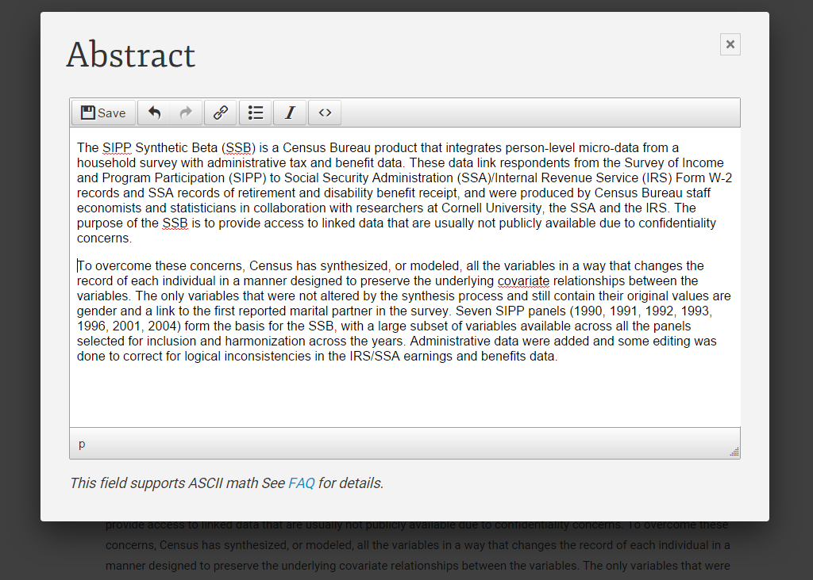
Internal Processing: Hand Editing

Slide 86
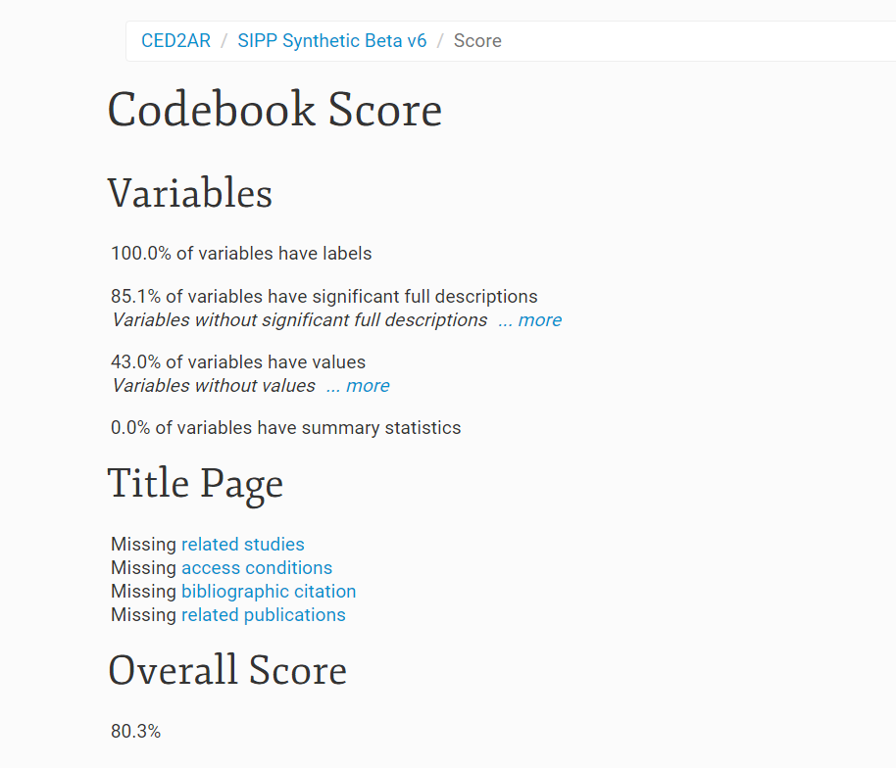
Internal Processing: Scoring
Provide feedback to improve sparse documentation

Slide 87
Fine-grained access controls
Important when working with confidential (meta)data

Slide 88
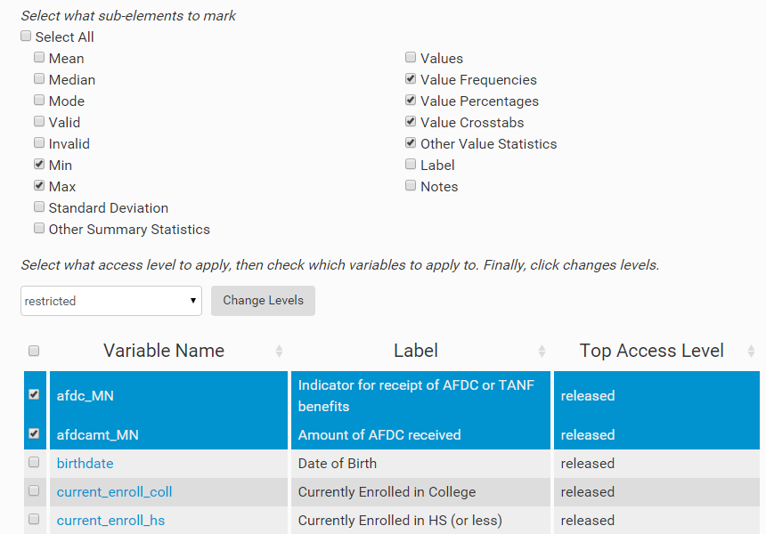
Internal Processing: Access Control
Marking elements with different restrictions
Notes:
Gives users the ability omit specific elements such as summary statistics, and frequencies

Slide 89
Workflow control
Ability to view additions/subtractions
Between versions
Between crowd-sourced information and official information
Ability to control access
Editing versus viewing
Authentication and reputation

Slide 90
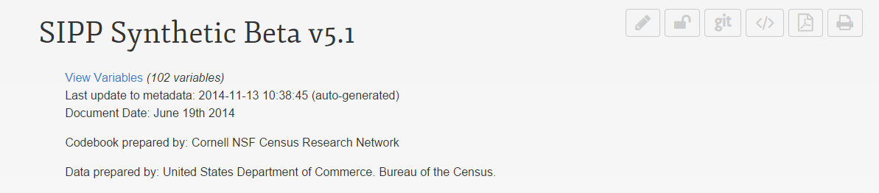
Versioning
Uses Git, a distributed version control system
Every aspect of the system is configurable
Scheduled tasks check for changes
Once changes exceed threshold, they are pushed
Remote instances pull changes on demand
Notes:
All instance use versioning!

Slide 91
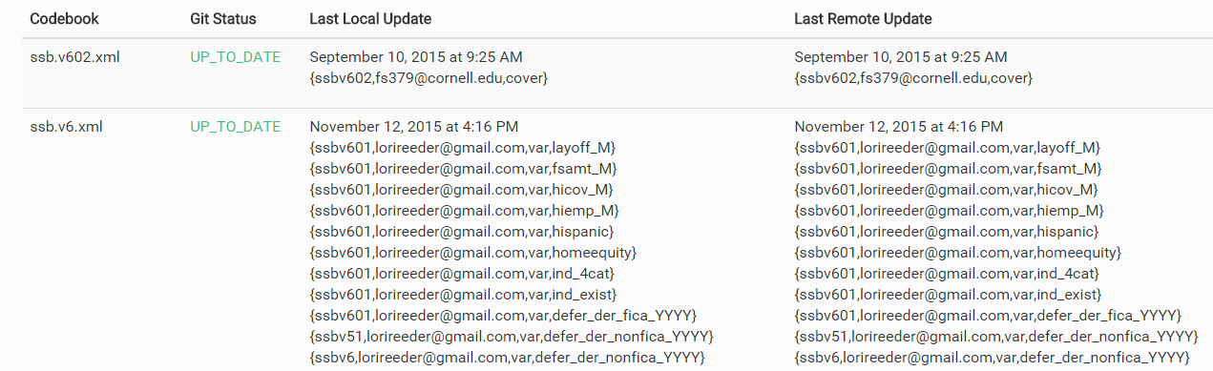
Combining Knowledge
Viewing changes made
Notes:
Managing a distributed network of metadata

Slide 92
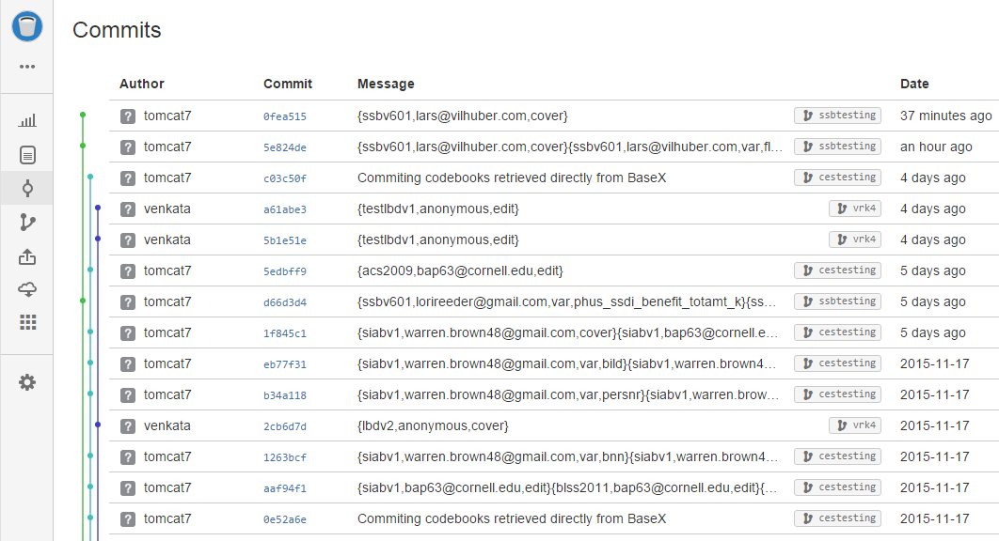
Versioning
All changes are logged externally via Git

Slide 93
Basic Information Flow
Staging Area
Public Facing
Official
Metadata
Datasets
Internal
Metadata
User switches
Crowdsourced
Metadata
93
Notes:
Public facing instances can ingest metadata from staging area on demand

Slide 94
Basic Information Flow
Staging Area
Public Facing
Official
Metadata
Datasets
Internal
Metadata
User switches
Crowdsourced
Metadata
94

Slide 95
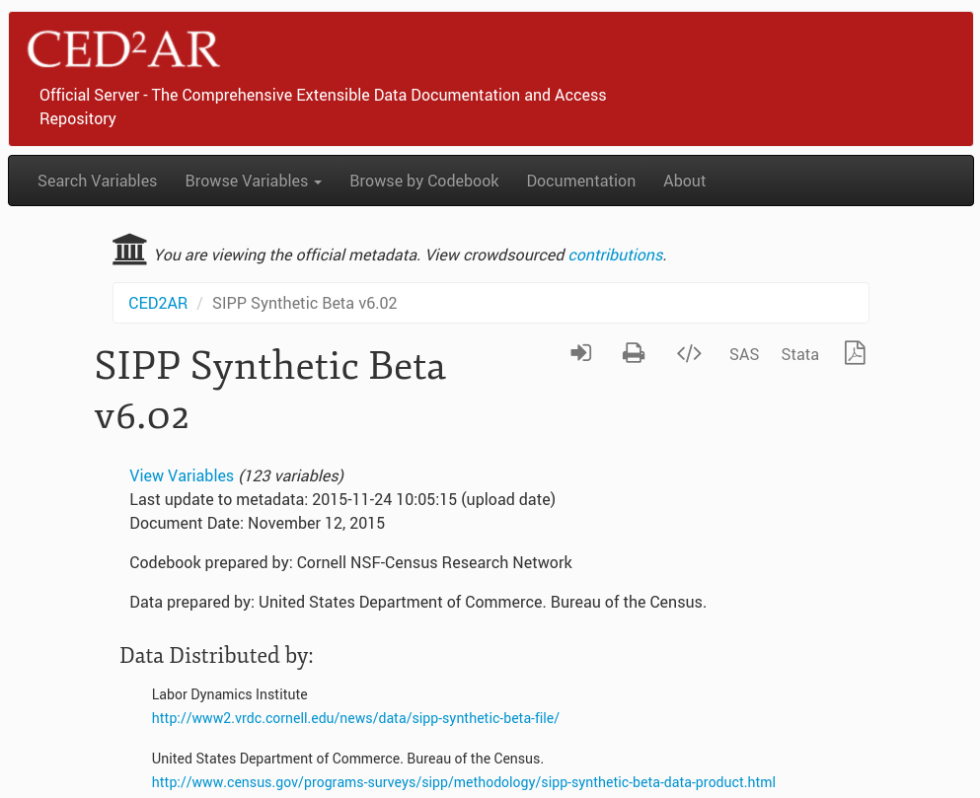

Official view

Slide 96
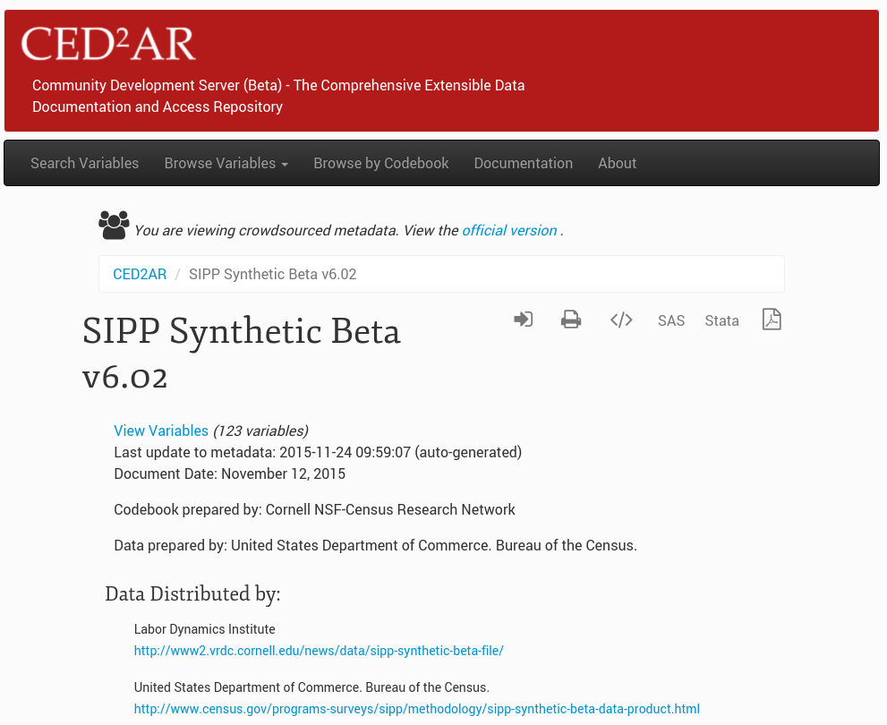

Crowdsourced view

Slide 97
Authentication and Attribution
When opening up contributions to a wide audience, how to triage between “rants” and meaningful contributions?
Here: Use of ORCID (academic network) for authentication
Public attribution with link to (verified) academic ID is key for positive feedback (your effort is recognized) and prevention of negative contribution (your rant is traceable to you!)

Slide 98

Authentication
Supports OpenID and OAuth2
Currently using Google and ORCID with OAuth2
Developing connectors to work with additional providers
CED²AR handles identity management
Notes:
Authentication is also important internally (small-workgroup editing!)
Possible Providers:
-Office 365 via Azure Active Directory
-GitHub
-Stack Exchange
-Facebook
-LinkedIn

Slide 99
Editing made easy

Slide 100
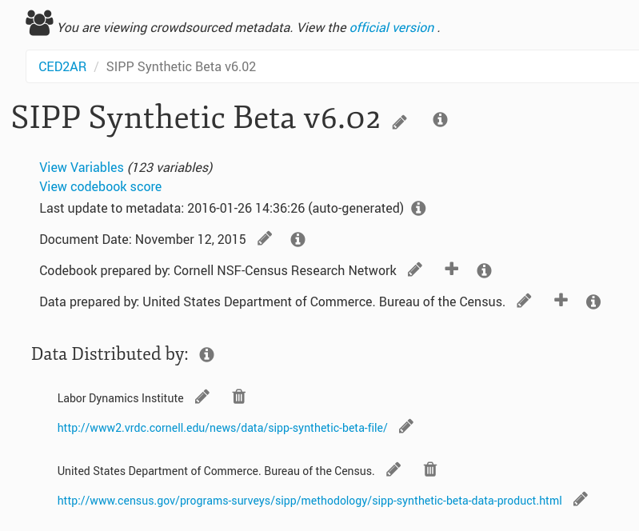

Slide 101
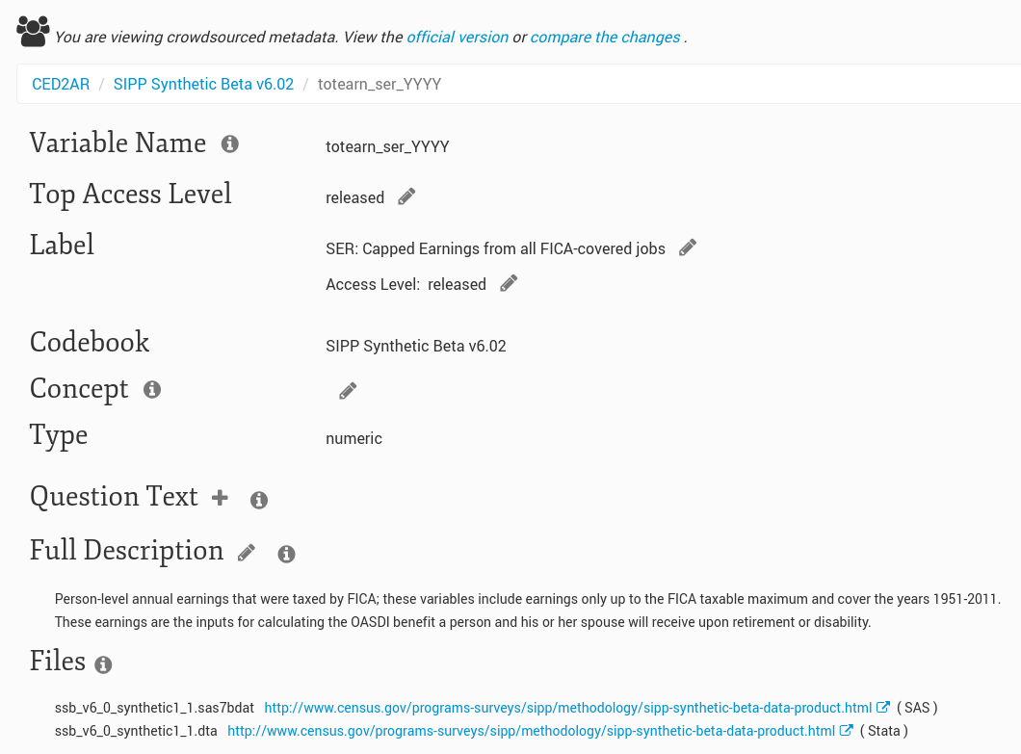

Slide 102
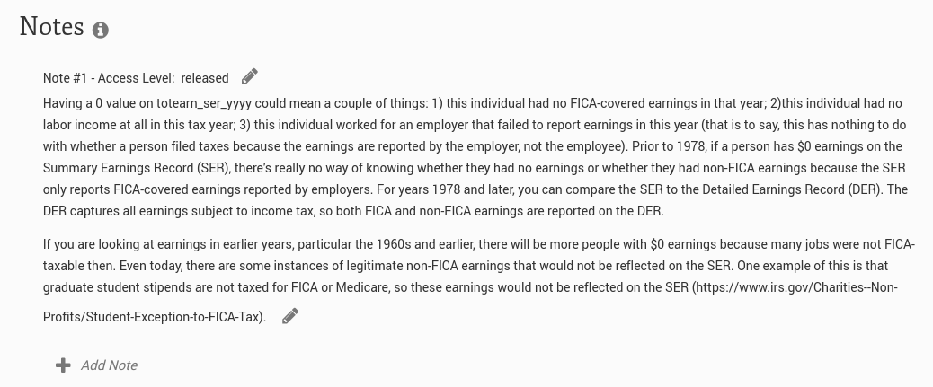

Slide 103
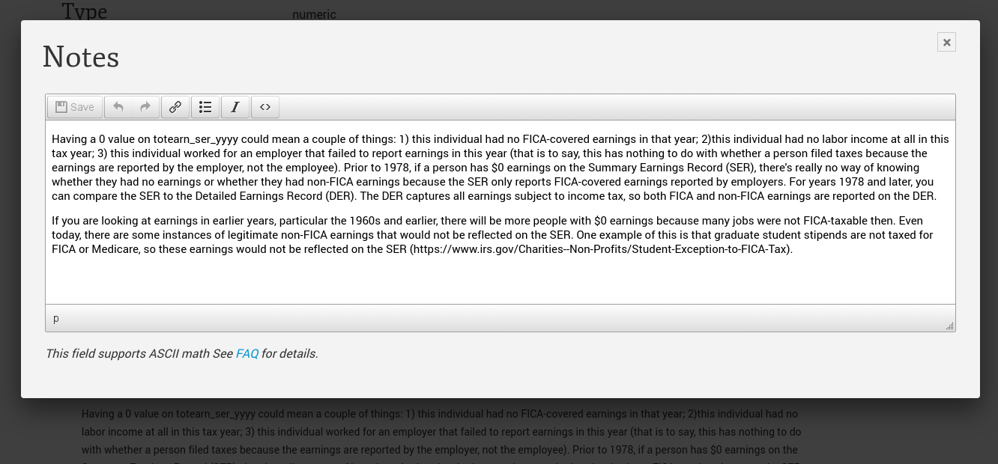

Slide 104
Basic Information Flow
Staging Area
Public Facing
Official
Metadata
Datasets
Internal
Metadata
User switches
Crowdsourced
Metadata
104

Slide 105
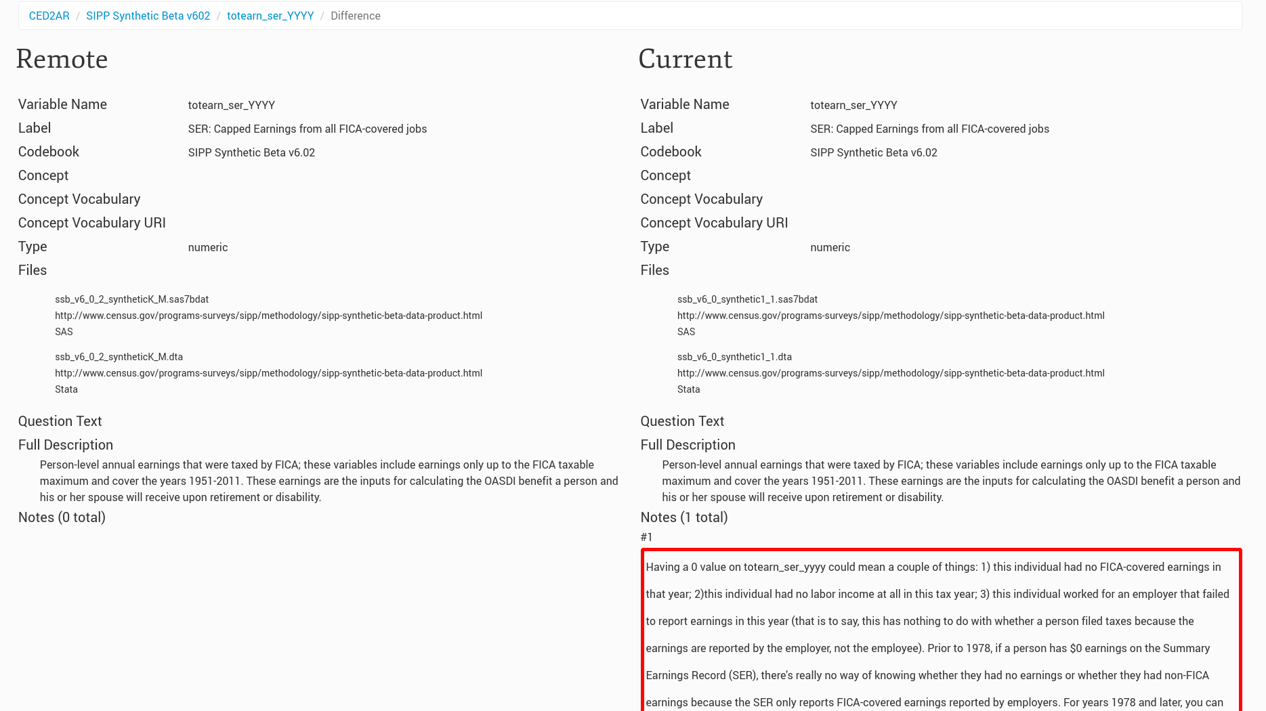
Everybody can see changes

Slide 106
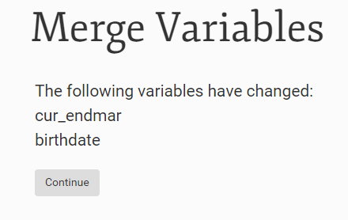
Combining Knowledge: Merging
Curators are given an interface to merge crowdsourced documentation with official

Slide 107
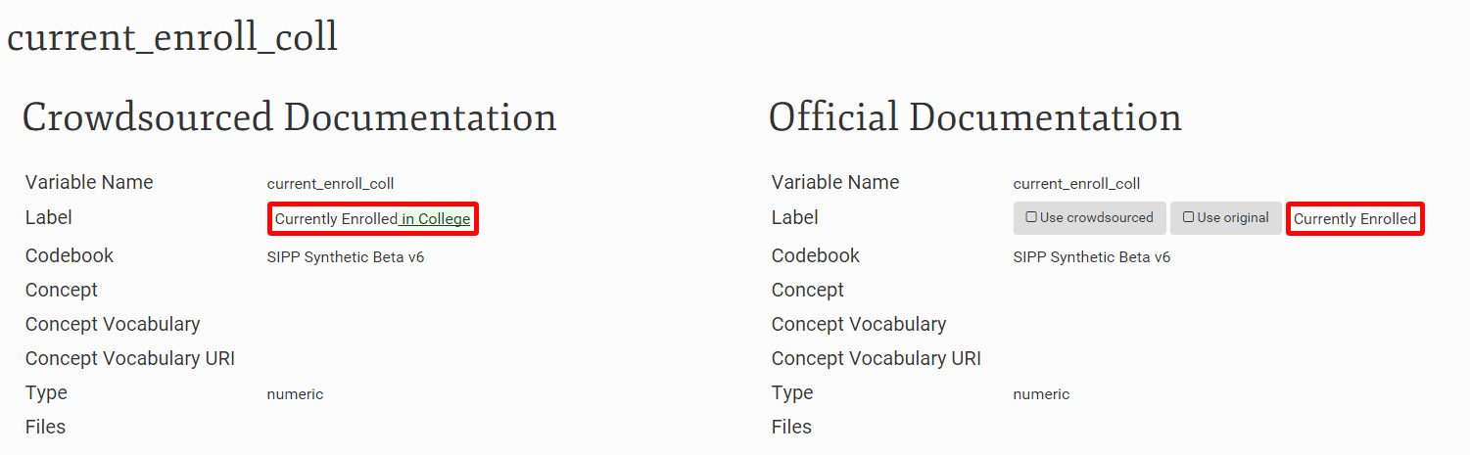
Combining Knowledge: Merging

Slide 108
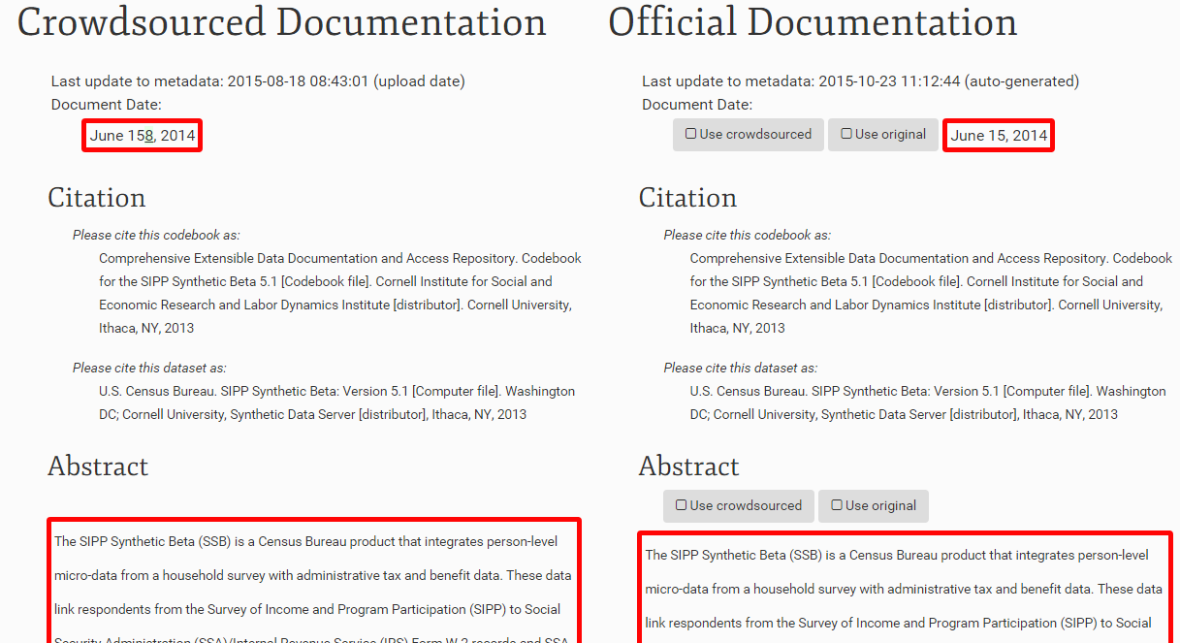
Combining Knowledge: Merging

Slide 109
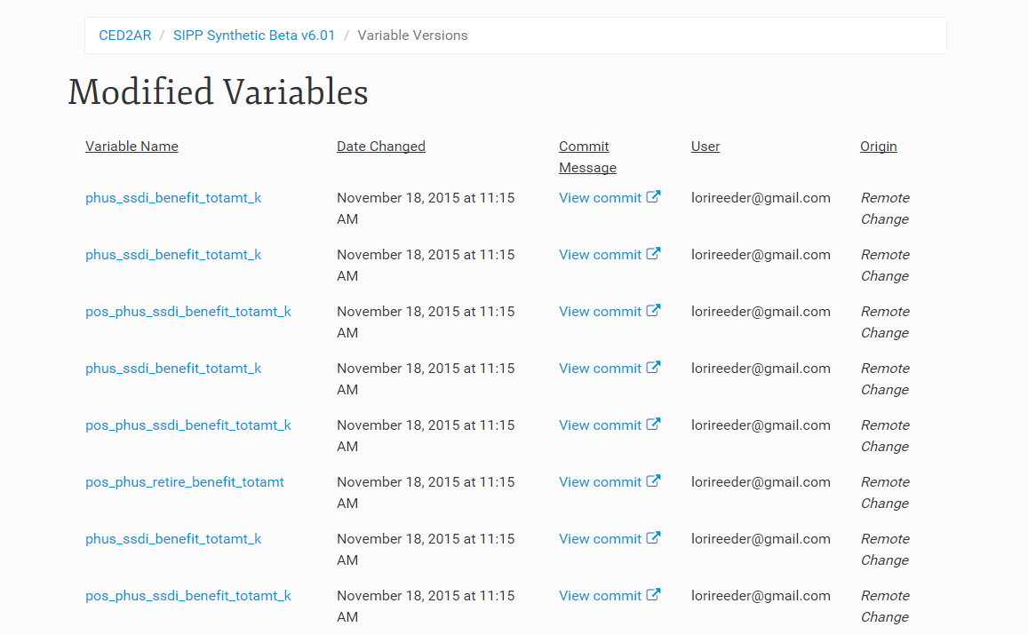
Combining Knowledge: Citations
Contributors can be tracked for each of their changes

Slide 110
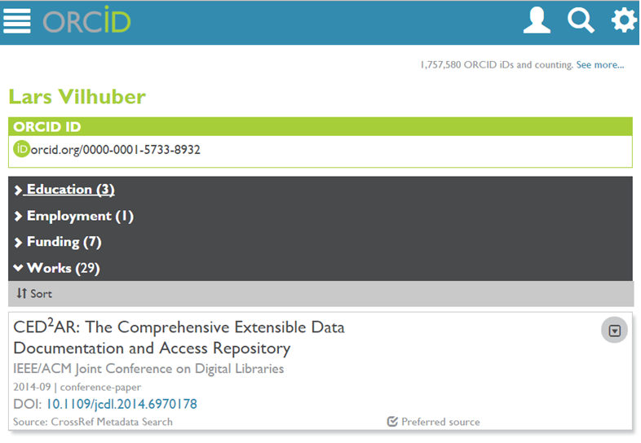
Combining Knowledge: Citations

Slide 111
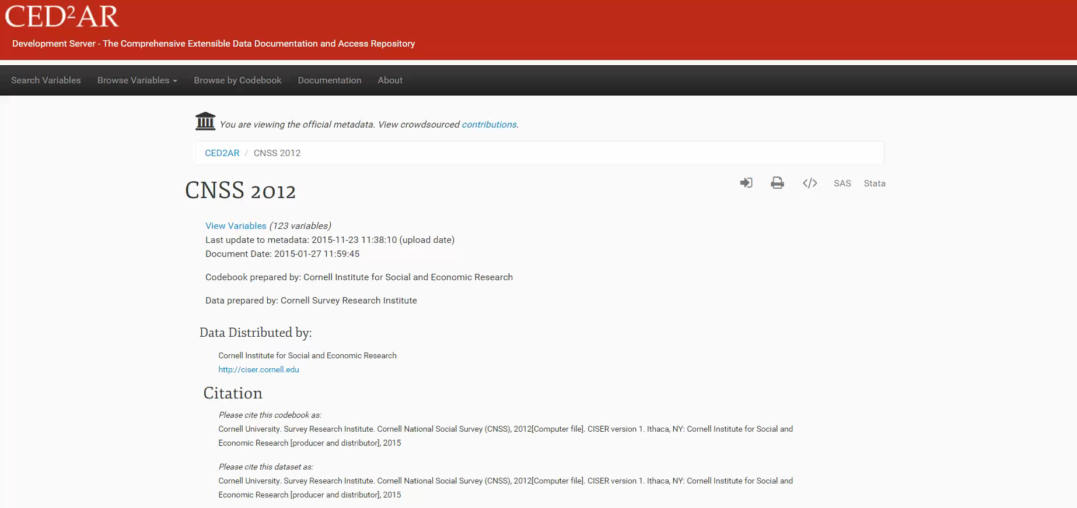
Demo
Try for yourself: http://demo.ncrn.cornell.edu

Slide 112
Future Directions
Where are we taking the project?
RePEC integrations?
Additional authentication tied to existing (document) metadata
“Claiming” user-created datasets
Entry-point to discover datasets (data provenance) and therefore need for documentation
Notes:
TODO: Add to this slide

Slide 113
Where does this leave us?

Slide 114
Making metadata easier to create
For researchers:
Training
Better knowledge dissemination
For data providers
Faster provision of data
Possibility of letting users document data in structured fashion
For data curators
Delegation of work in a productive way to data experts
Control over workflow of enhancements

Slide 115
Things we didn’t solve
Catch-22 of data providers who cannot release data to archives (role for libraries, RDCs)
Making better programmers out of social scientists (on average)
What to have for lunch

Slide 116
Thank you!
Questions?
ced2ar-devs-l@cornell.edu

Slide 117
Extra Slides

Slide 118
Technologies Used
What technologies are used to build CED²AR?
Server: Apache/Tomcat
Databases: BaseX and Neo4j
Primary Languages/Frameworks:
Java
Spring MVC
Bootstrap, JQuery, LESS

Slide 119
Generating Metadata
Convert data to metadata
Online or offline conversion
Can start with Stata, SPSS, SAS, R, ASCII or a relational DB
We generate DDI 2.5 (codebook)

Slide 120
Architecture
Codebook 1.0
Master Branch (Official version)
1. User gets copy of DDI to edit
User Contributed Branch
Codebook 1.0
Notes:
User works off their own branch, or copy of the official codebook

Slide 121
Architecture
Codebook 1.0
Master Branch (Official version)
1. User gets copy of DDI to edit
User Contributed Branch
Codebook 1.0
Codebook 1.0 rev 1
Codebook 1.0 rev 2
…
Codebook 1.0 rev N
2. Each edit is versioned
Notes:
User make revisions to DDI
As they do so, the data owner can see these changes

Slide 122
Architecture
Codebook 1.0
Master Branch (Official version)
Codebook 1.1
1. User gets copy of DDI to edit
3. Data provider merges user’s edits back into official DDI
User Contributed Branch
Codebook 1.0
Codebook 1.0 rev 1
Codebook 1.0 rev 2
…
Codebook 1.0 rev N
2. Each edit is versioned
Notes:
At a certain point the data owner decides to merge any of the user’s changes back into the official version

Slide 123
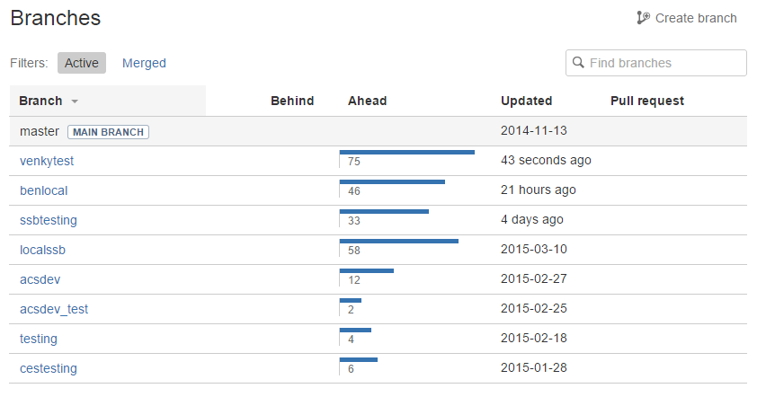
Architecture
Notes:
In reality, each network of CED2AR instances has more than two branches
A branch can track all the change on one server
Or all the changes on a single user’s desktop

Slide 124
Architecture
Server
Database
Web
Application
Local Repository
Remote
Repository
Notes:
Database only has valid DDI XML
Web application controls data flow
Access to the repository can vary, and can be manually changed or updated with ced2ar

Slide 125
Architecture
CED²AR Instance
Server
Remote
Repository
Notes:
Everything within a single server we refer to as an instance of ced2ar

Slide 126
Architecture
CED²AR Instance
Remote
Repository
CED²AR Instance
CED²AR Instance
CED²AR Instance
Notes:
-CED2AR is not a single website

Slide 127
Architecture
CED²AR Instance
Remote
Repository
CED²AR Instance
CED²AR Instance
(Official)
CED²AR Instance
CED²AR Instance
Notes:
Official copy describes authoritative copy can be found

Slide 128
Remote Location
Our implementation uses Bitbucket
Commit messages describe changes
Users linked by email address
Commit hashes are stored on CED²AR
Remote synchronization is optional
Notes:
-Changed synchronized with cloud based repository called BitBucket
-Changes are available to view or download online
-Each commit is a compilation of changes
--Within the commit message, user’s edits are referenceable by unique elements in DDI and their email address

Slide 129
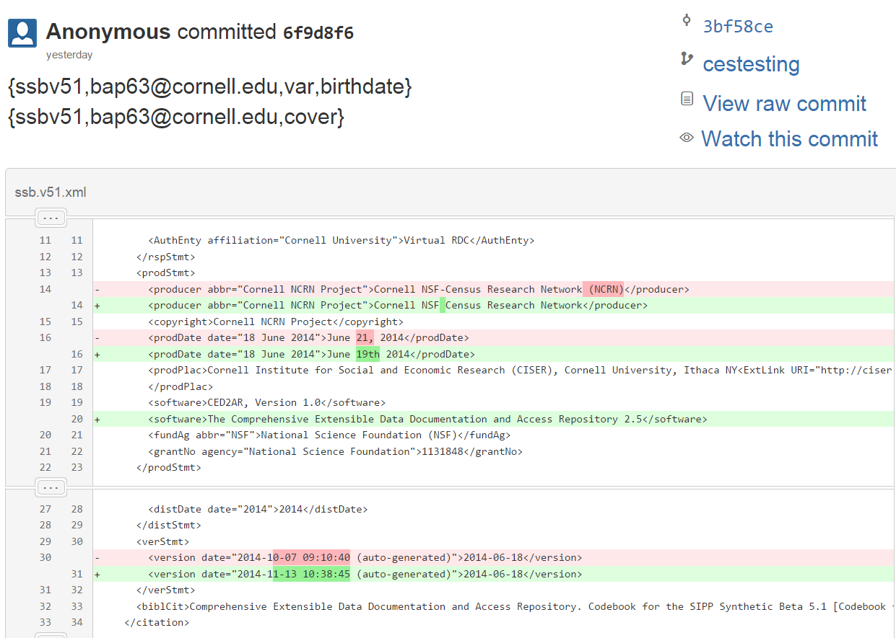
Remote Location
Notes:
Remote repository could be cloud based, local, or even offline
User has the possibility to disable remote pushes

Slide 130

Tracking Changes
Notes:
Control to manage the flow of metadata This allows you to:
-Add codebooks from other instances
-Resolve conflicts
-Delete invalid codebooks
-Push or pull changes

Slide 131
Continued Work: Improving merge control
Codebook 1.0
Master Branch (Official version)
Codebook 1.1
1. User gets copy of DDI to edit
3. Data provider merges user’s edits back into official DDI
User Contributed Branch
Codebook 1.0
Codebook 1.0 rev 1
Codebook 1.0 rev 2
…
Codebook 1.0 rev N
2. Each edit is versioned

Slide 132
Continued Work: The uncontrolled merge
Workflow as described assumes metadata curator merges information
Within the limits of a 24-hour day: what’s the likelihood that that process scales?
Alternate: “wiki” methodology

Slide 133
Architecture (alternate)
Master Branch (Official version)
Codebook 1.0
Wiki Branch (Community version)
Codebook 1.0
Notes:
The data provider maintains the master branch of metadata, which is practically read only.
The from the master branch, a wiki branch, or community branch is contributed.

Slide 134
Architecture (alternate)
Master Branch (Official version)
Codebook 1.0
Wiki Branch (Community version)
Codebook 1.0
2
User Branches
Users pull from wiki branch into any instance of CED²AR
1
Notes:
As users edit on different platforms they

Slide 135
Architecture (alternate)
Master Branch (Official version)
Codebook 1.0
Wiki Branch (Community version)
Codebook 1.0
Codebook rev 1
2
User Branches
Users push back to branch manually
1

Slide 136
Architecture (alternate)
Master Branch (Official version)
Codebook 1.0
Wiki Branch (Community version)
Codebook 1.0
Codebook rev 1
2
User Branches
3
1
New users work off most recent revision by default

Slide 137
Architecture (alternate)
Master Branch (Official version)
Codebook 1.0
Wiki Branch (Community version)
Codebook 1.0
Codebook rev 1
…
Codebook rev X
2
User Branches
3
1

Slide 138
Architecture (alternate)
Master Branch (Official version)
Codebook 1.0
Wiki Branch (Community version)
Codebook 1.0
Codebook rev 1
…
Codebook rev X
2
User Branches
3
1

Slide 139
Architecture (alternate)
Master Branch (Official version)
Codebook 1.0
Wiki Branch (Community version)
Codebook 1.0
Codebook rev 1
…
Codebook rev X
2
User Branches
User is responsible for merging
3
1

Slide 140
Architecture (alternate)
Master Branch (Official version)
Wiki Branch (Crowdsource version)
Codebook 1.0
Codebook rev X
CED²AR User Interface exposes both versions
(with attribution)

